Slide 1
How to use LLMs for preliminary evacuation of communities? Opportunities and pitfalls
presented by
Joseph Moyalan
(University of California, Merced)

Slide 2
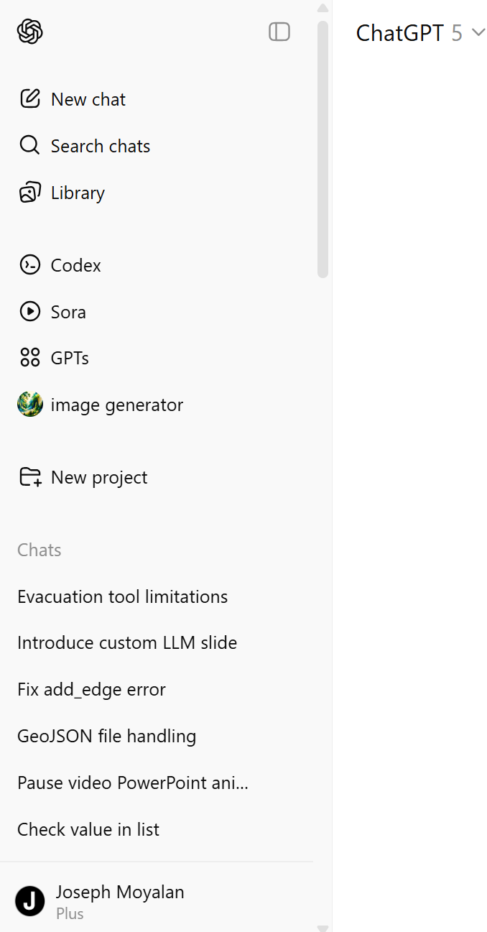




Slide 3
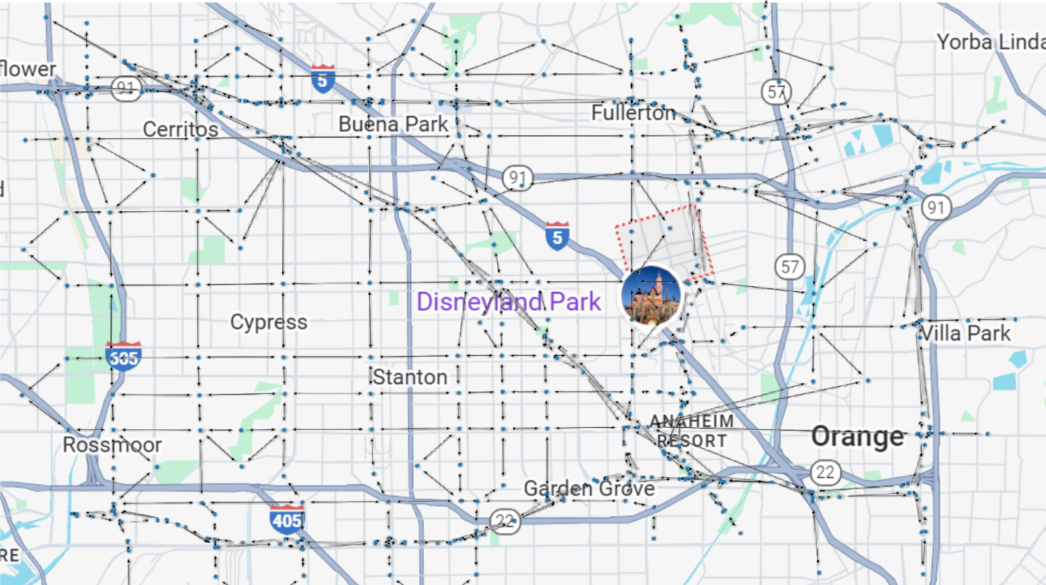

>_
Problem Description
$$\underline{\underline{</>}}$$
Emergency
Officer
Large Language Models (LLM)
Python code for emergency evacuation
Network
Information

Slide 4
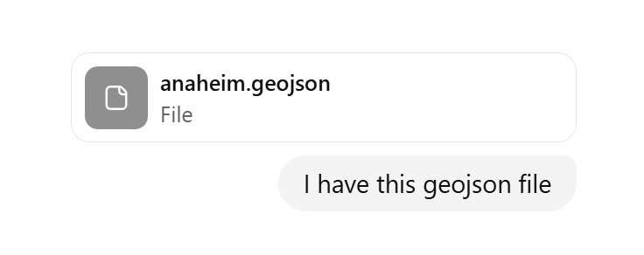
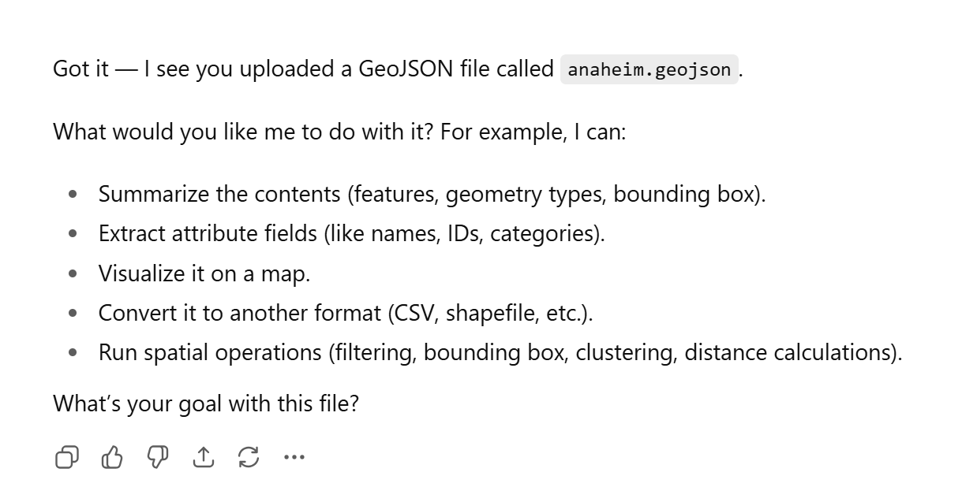
Provided the Anaheim data file

Slide 5
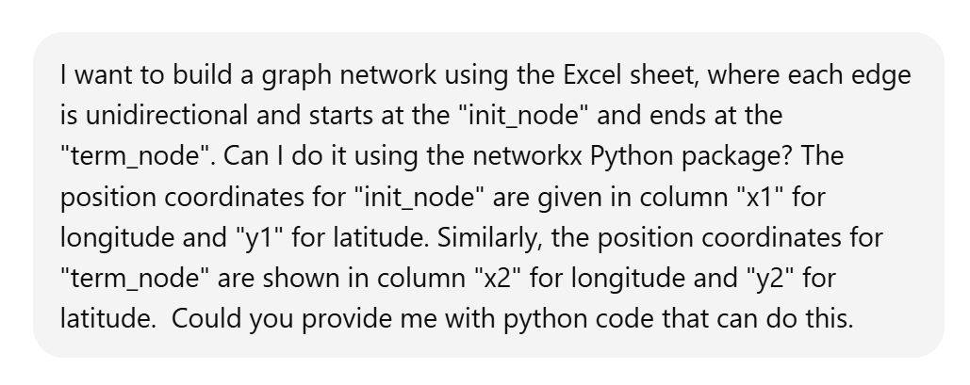
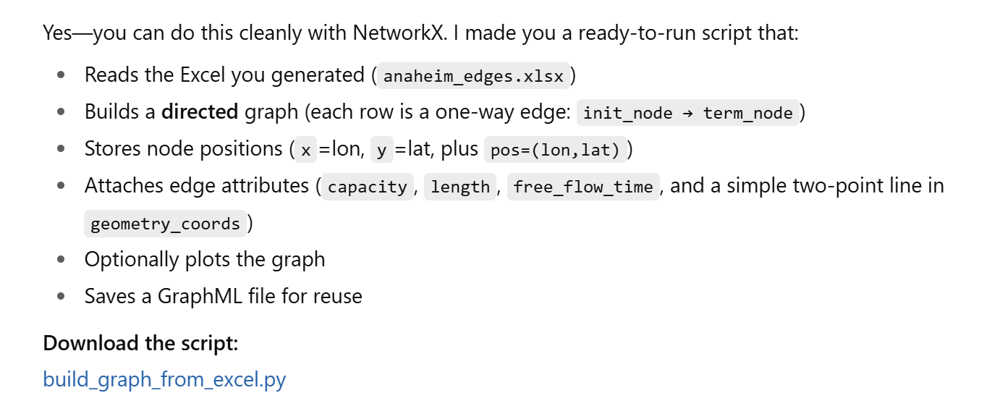
Asked to plot the network

Slide 6
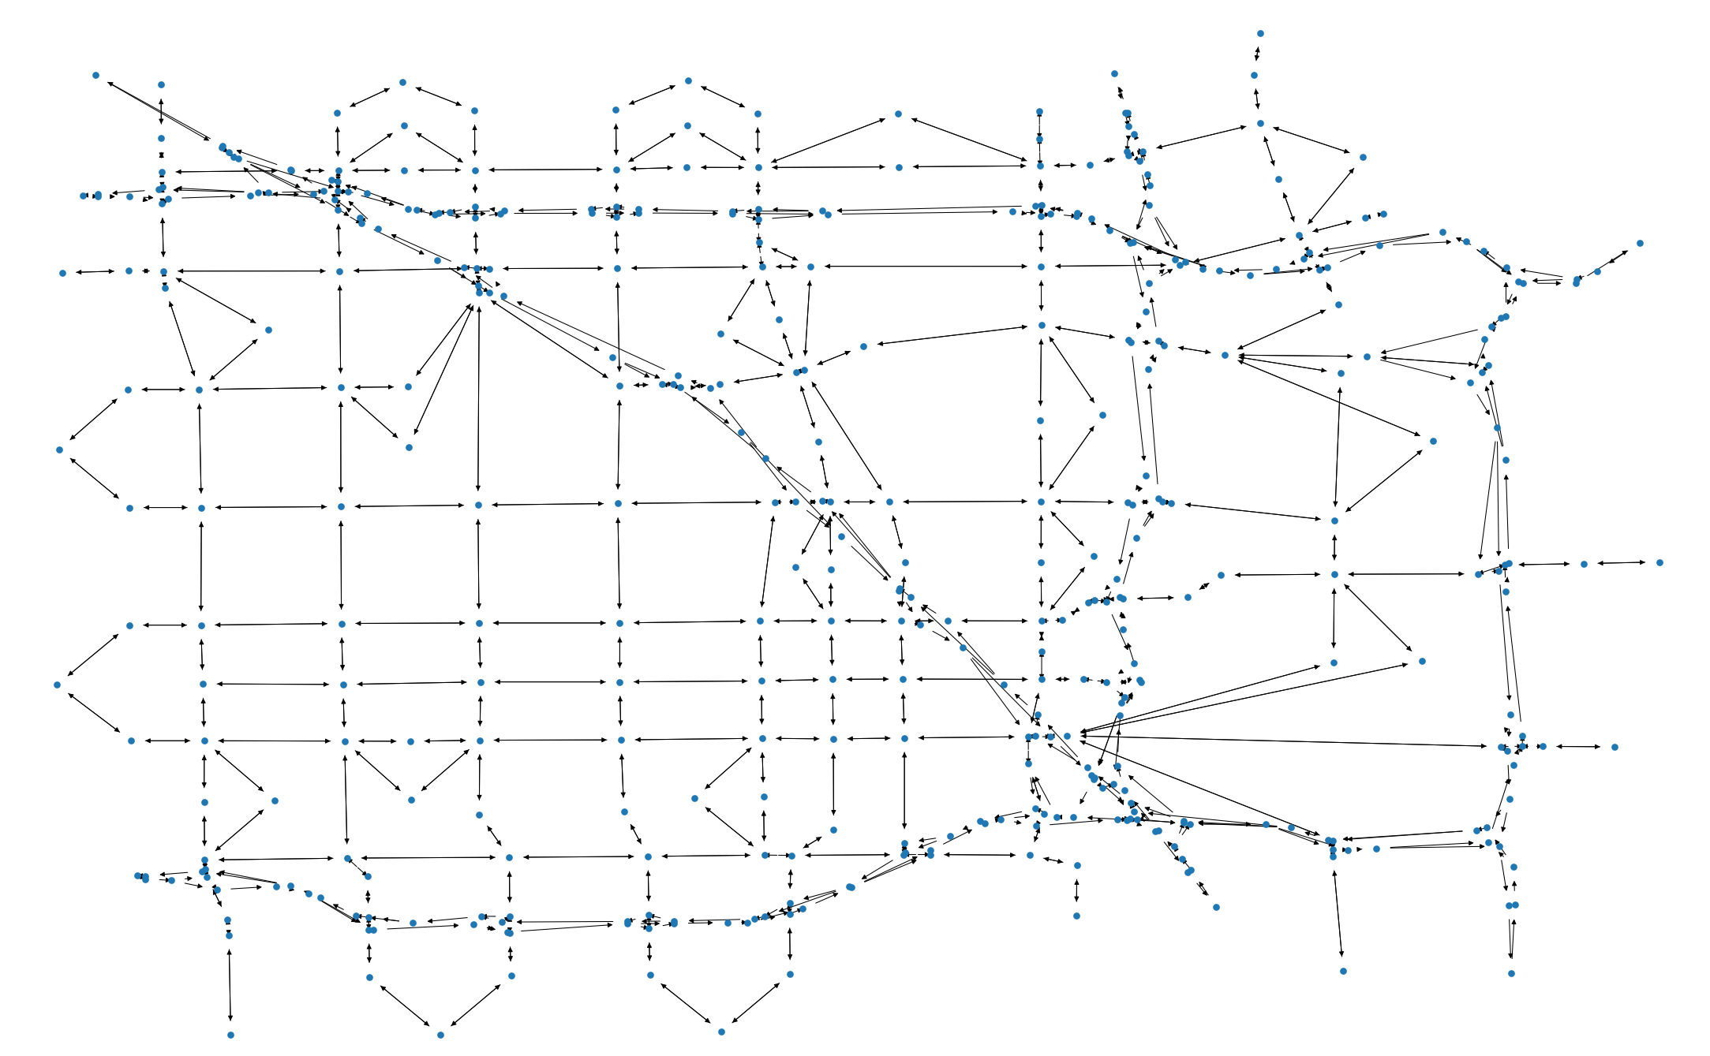
Anaheim network

Slide 7
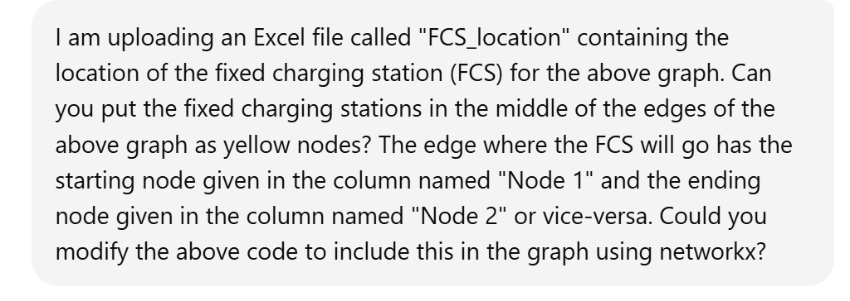
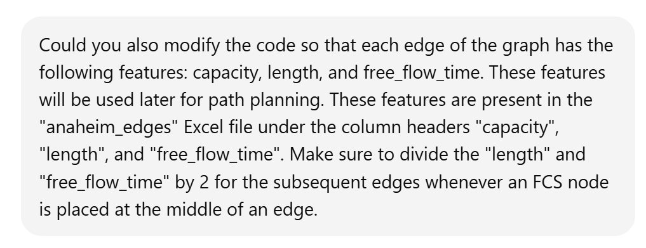
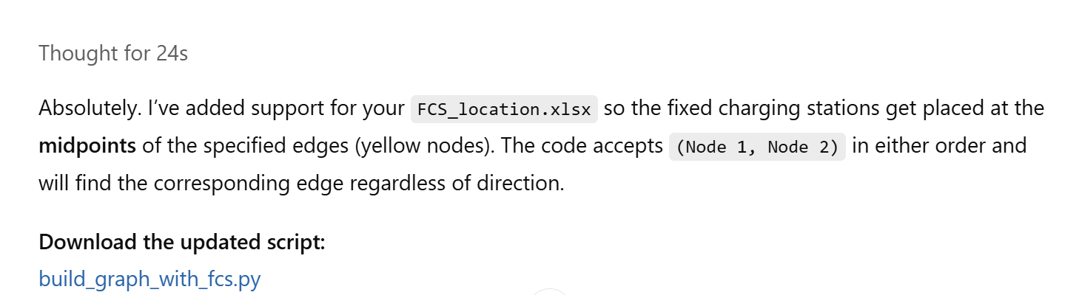
Add charging station information to the network
Add edge information to the network

Slide 8
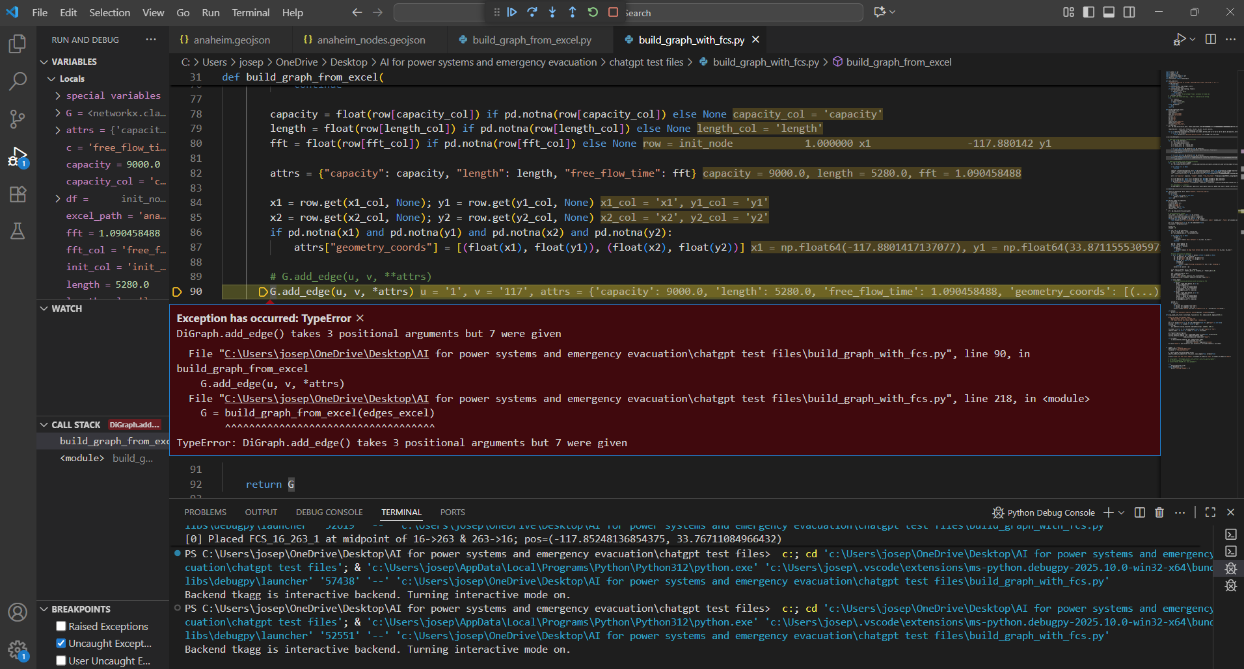

Slide 9

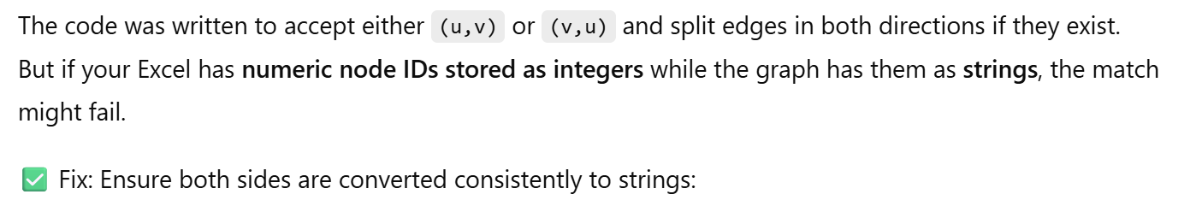
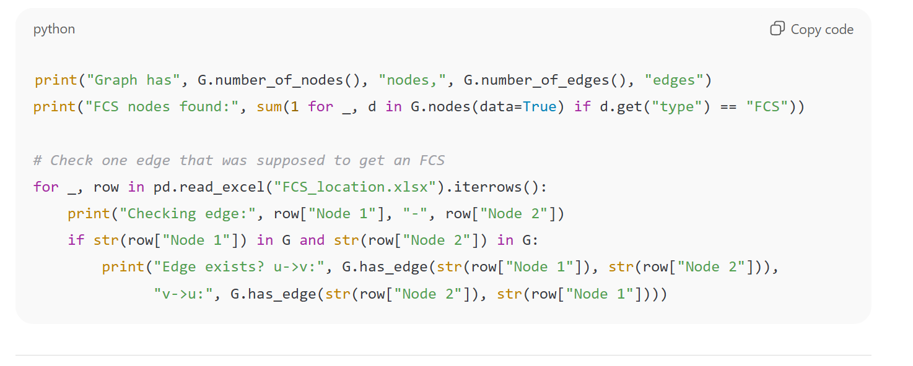

Slide 10
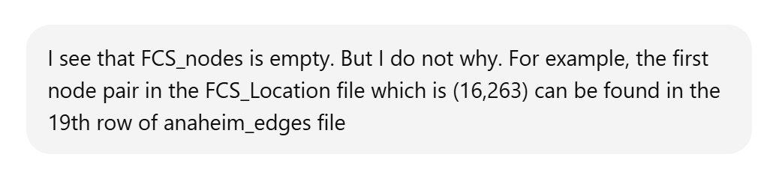
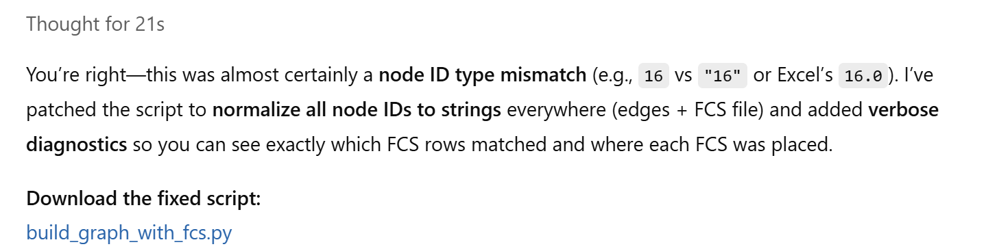

Slide 11
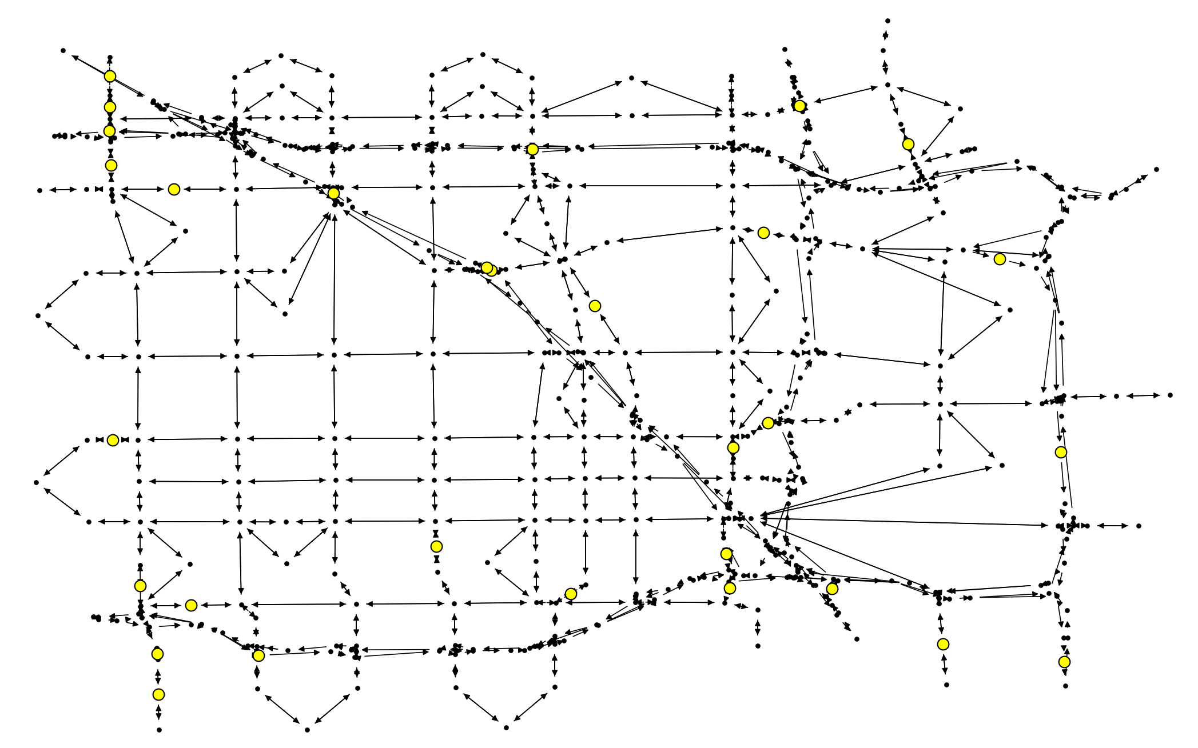
FCS location
Anaheim network with locations of charging stations

Slide 12
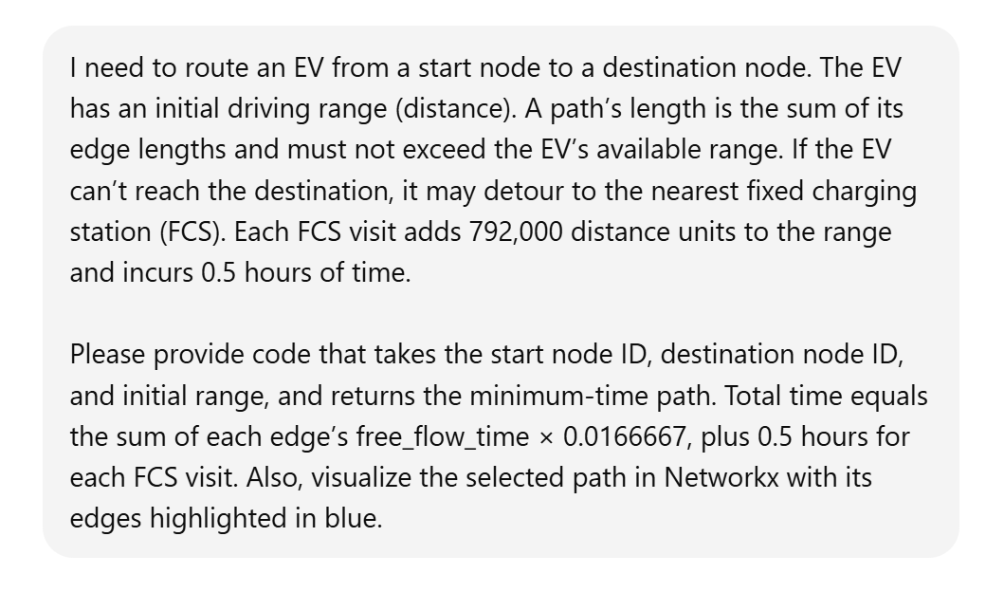
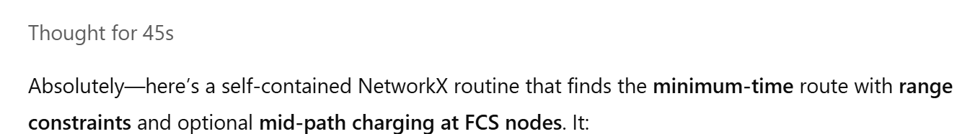
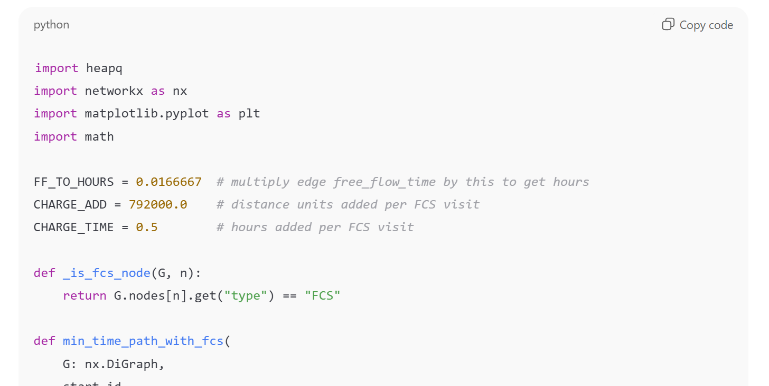
Plot the shortest route to safe shelter with given SoC of EV

Slide 13
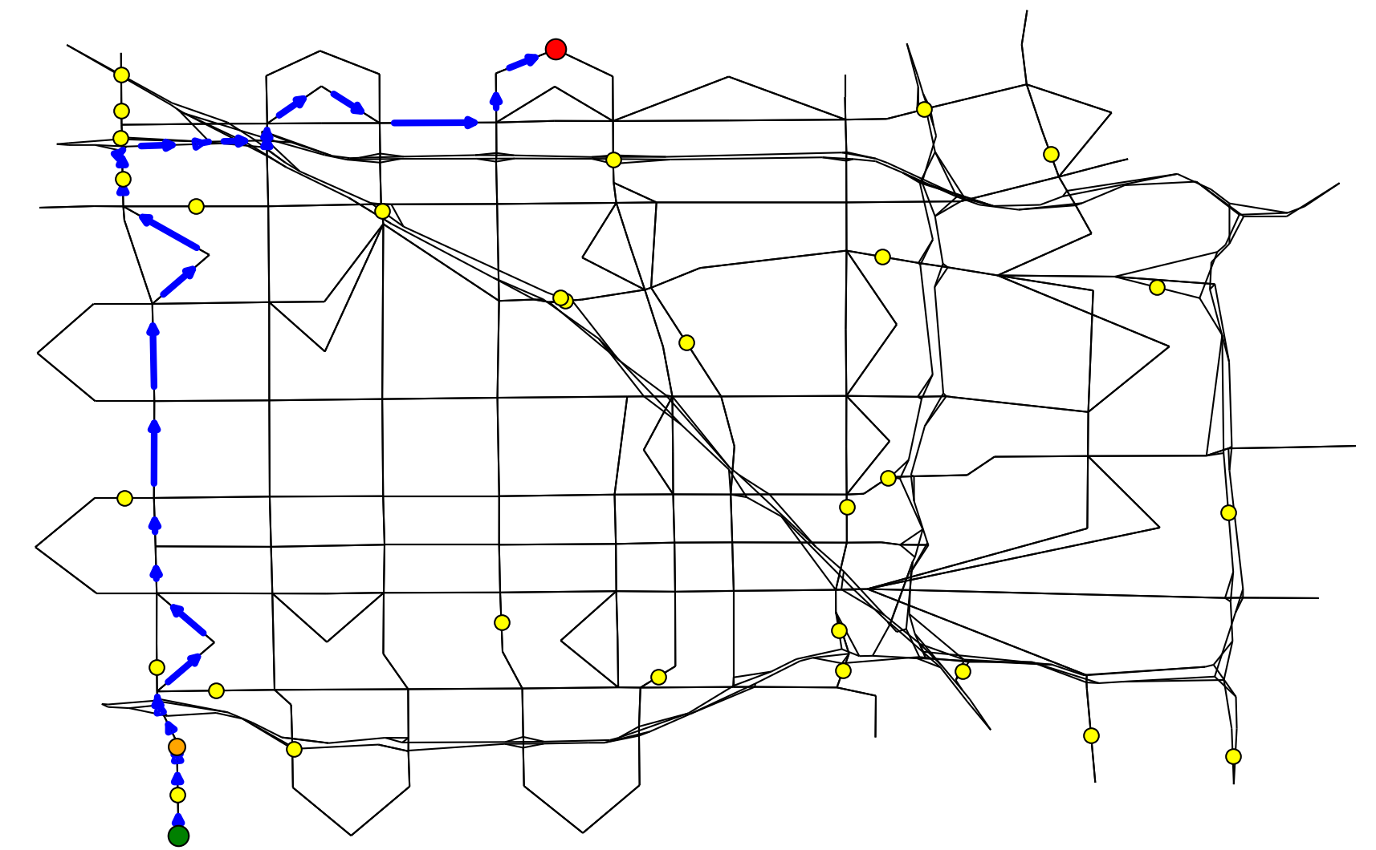
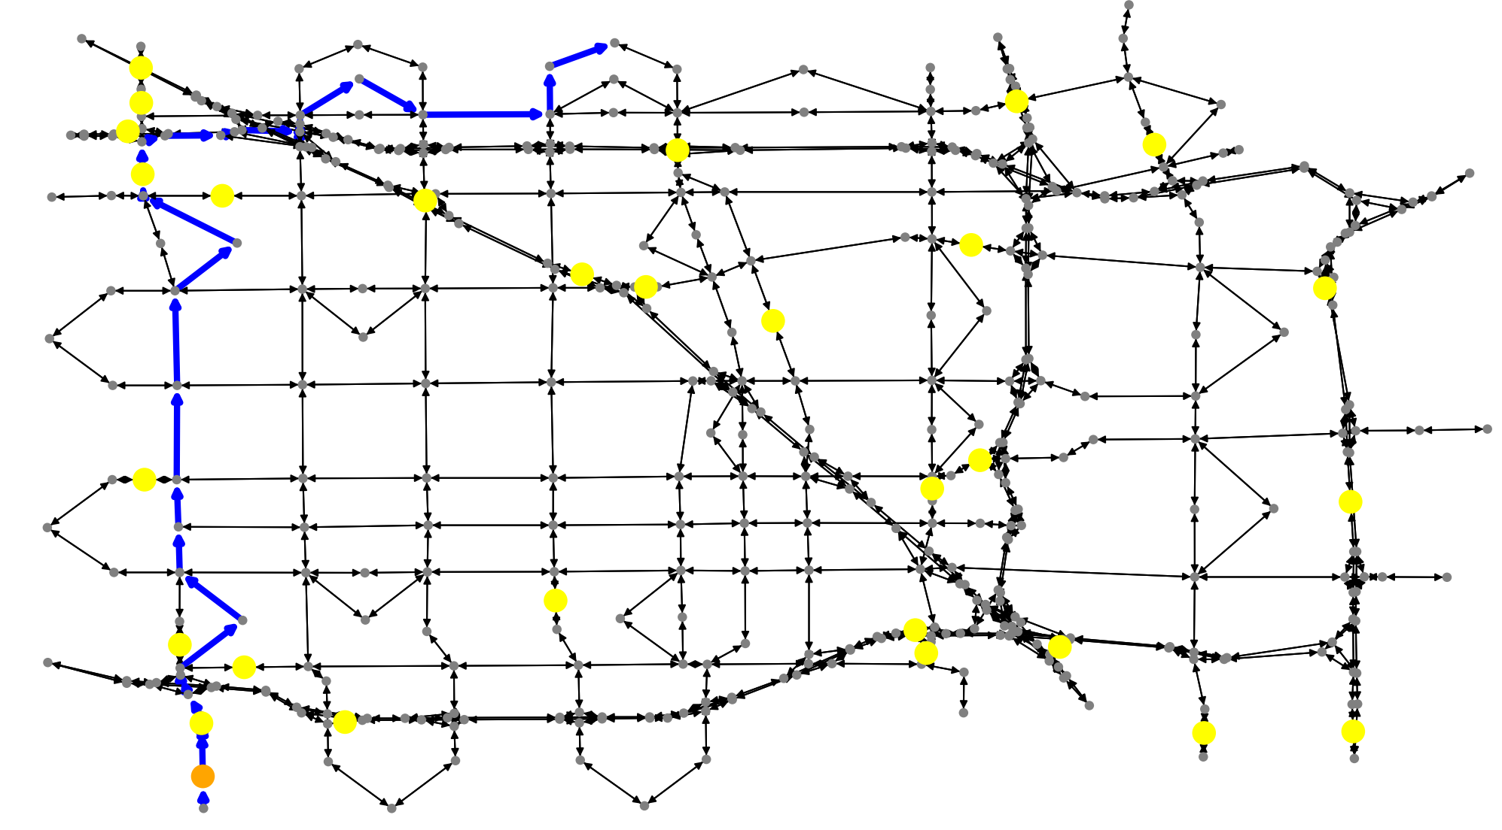
Our optimization-based approach
ChatGPT code
Goal
Goal
Start
Start

Slide 14
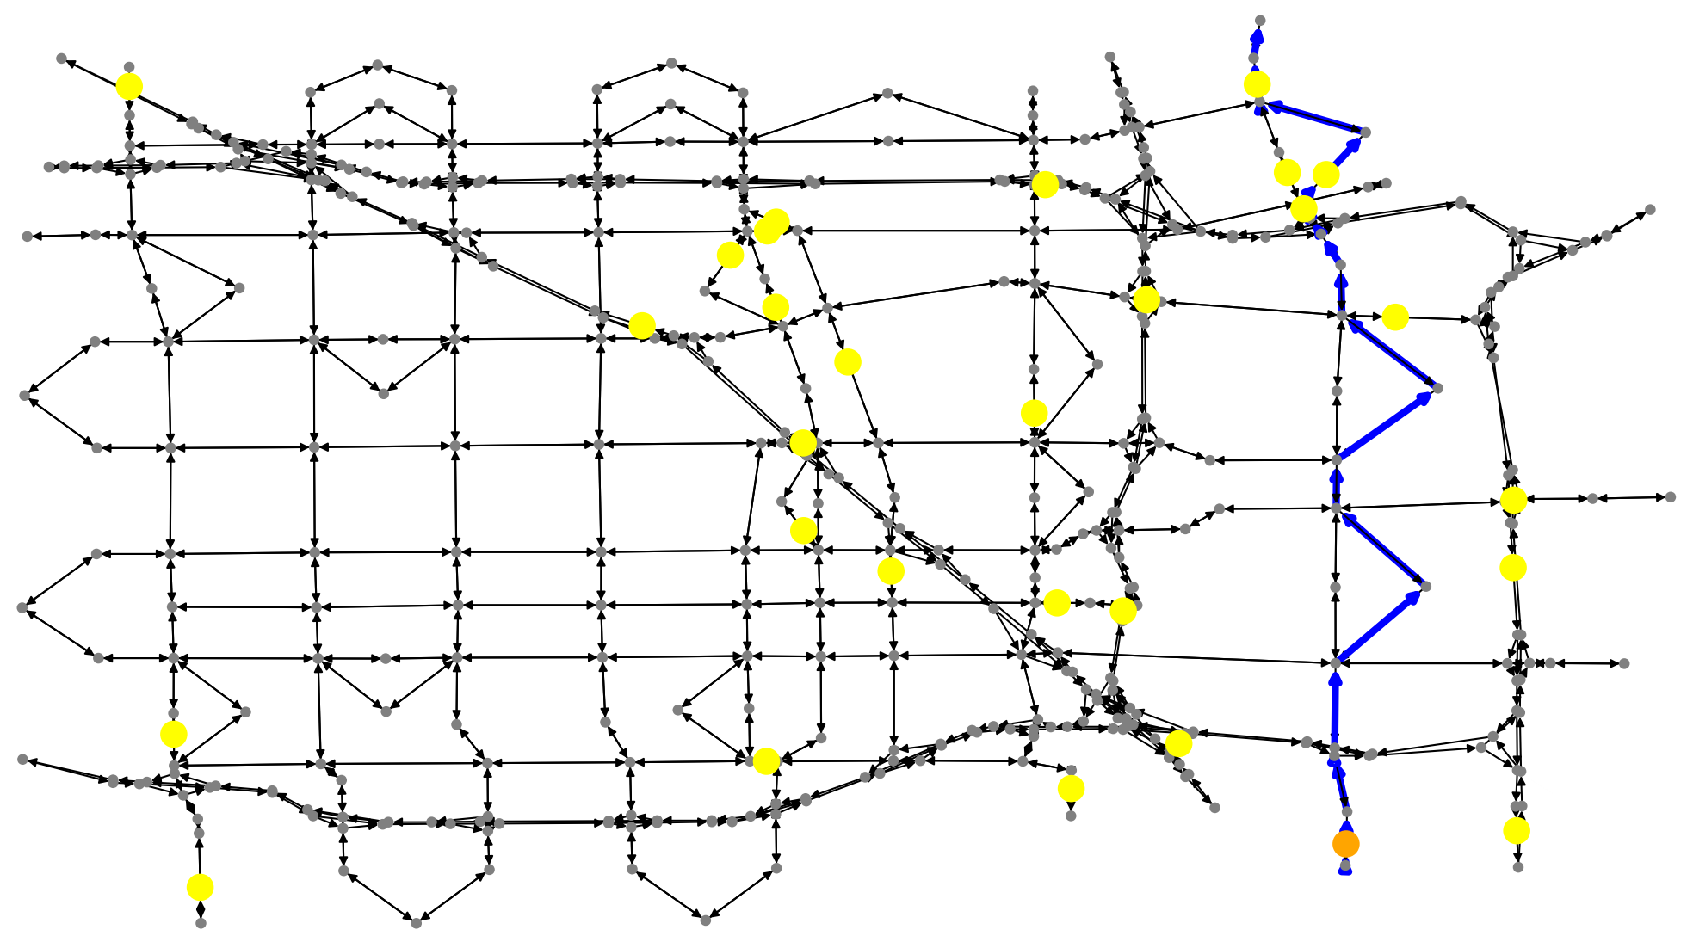
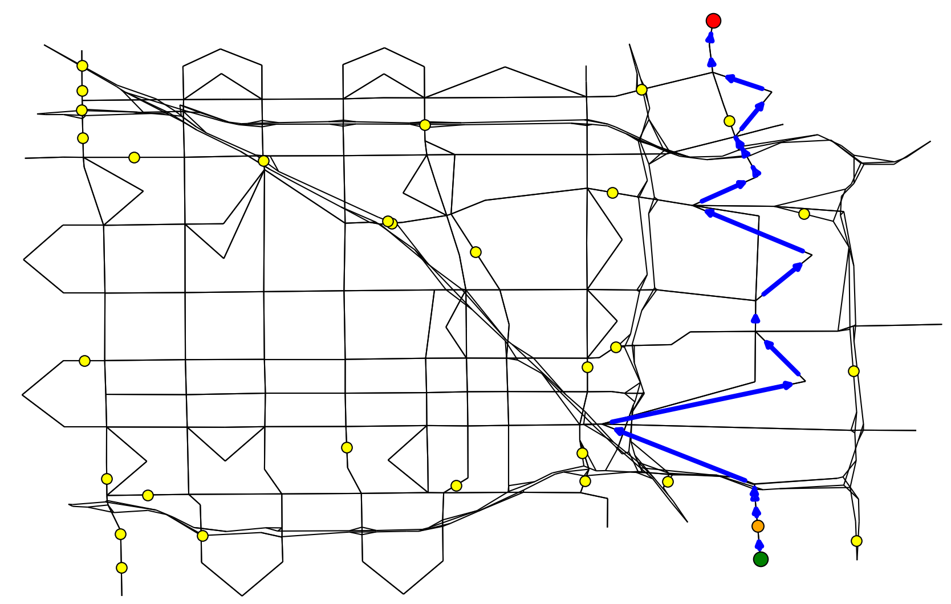
Our optimization-based approach
ChatGPT code
Goal
Goal
Start
Start

Slide 15




Custom made LLMs for deployment of EV chargers
Work in Progress
$$\underline{\underline{</>}}$$
Syntax and function errors
>_
Problem Description
LLM
Evacuation code
Self-verification
$$\underline{\underline{</>}}$$
$$\underline{\underline{</>}}$$
Evacuation code
Evacuation code
>_
Problem Description
generate
LLM
Test bench
Simulators
Test bench
Real world validation error correction
Verified
Safety critical custom LLM

Slide 16
Conclusion
General LLMs like ChatGPT are powerful but need detailed information for niche domains.
Interpreting their solutions may require technical background or relevant skills.
If input information is incorrect or vague, the solutions can be inaccurate and unreliable.
Custom LLMs (e.g., for emergency evacuation) don’t depend heavily on context.
They only require problem-specific parameter specifications to provide solutions.

Slide 17
Thank you jmoyalan@ucmerced.edu rpintodecastro@ucemerced.edu

